Slide 1
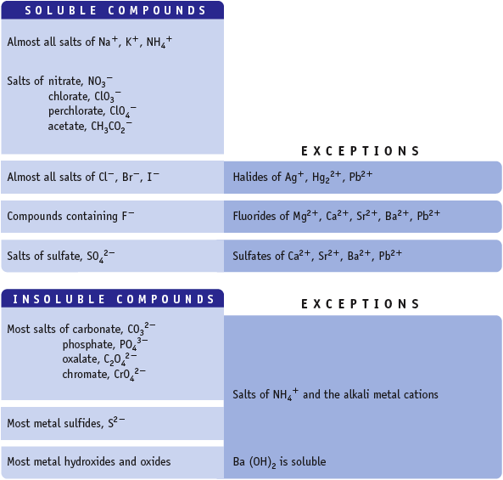
Water Solubility of Ionic Compounds
If one ion from the “Soluble Compd.” list is present in a compound, the compound is water soluble.

